Slide 1
CAFE COMPETITION IN TORONTO
BY: MD HUMAYAN FARIDI

Slide 2
INTRODUCTION
The problem which I plan to use Foursquare location data to solve the following: I plan to use the Foursquare API to help a new Café owner to locate the neighborhoods in the Toronto area which have the most competition. The target audience is a Cafe owner as such a program would allow him/her to discover the neighborhoods which should be avoided when setting up a shop, since these areas have a high frequency of Cafes already. Thus, there may be high saturation in those markets for Cafe products. This would greatly benefit a new owner who is unfamiliar to the Cafe business or the geography of the Toronto area. Rather than finding the number of Cafes manually, they can sort and map using the Foursquare location API.

Slide 3
DATA DESCRIPTION
The data being used will be two fold. First, data will be taken about the geographical coordinates of each neighborhood in Canada; it will be narrowed down to include only Toronto neighborhoods. This data will be taken from a postal code/neighborhood database. The postal codes will be converted to longitude and latitude coordinates so that they may be analyzed in the Foursquare API. The Foursquare API can then be used to find the frequency of various venues near each of the identified neighborhoods. The neighborhoods will then be sorted based on the frequency of Cafes in particular and then they will be clustered together based on similarity in this frequency. Then, the areas with the highest frequency of Cafe presence will be isolated and displayed on a map, with name labels for the user to identify.
I took this data from:
https://en.wikipedia.org/wiki/List_of_postal_codes_of_Canada:_M

Slide 4
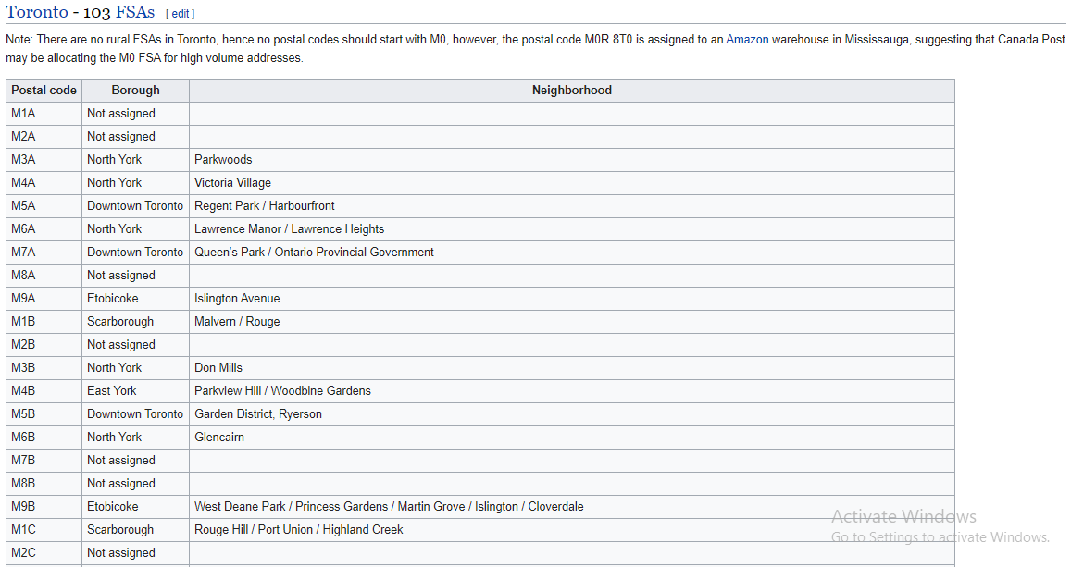
DATA DESCRIPTION

Slide 5
METHODOLOGY
Collect Inspection Data
Explore and Understand the Data
Data preparation and preprocessing
Modeling
Evaluation and Testing

Slide 6
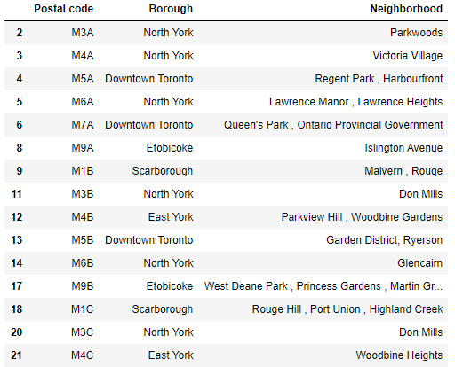
HTML TO DATAFRAME

Slide 7
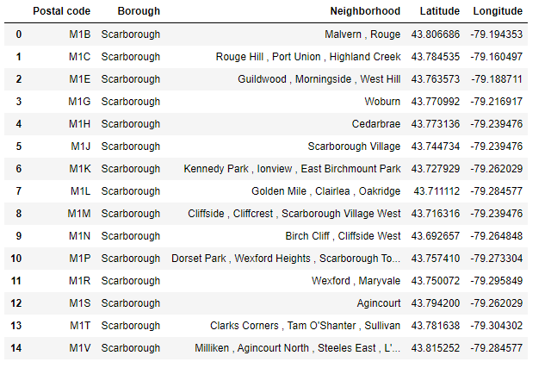
CLEANED DATA WITH LOCATION

Slide 8
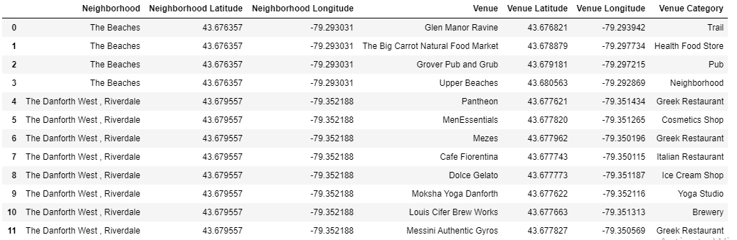
NEIGHBORHOOD WITH VENUE

Slide 9
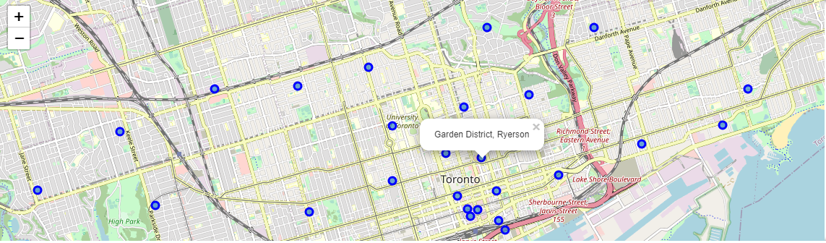
COPY OF TORONTO CITY MAP

Slide 10
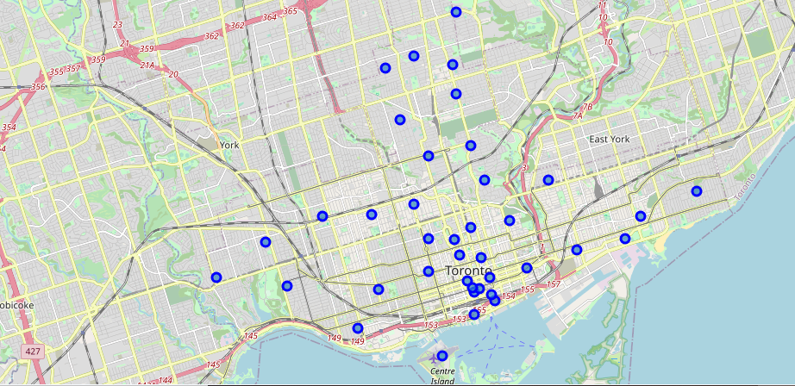
TORONTO CITY MAP

Slide 11
DISCUSSION
To reiterate, the main goals of this analysis were as follows. Use the Foursquare API to help a new Café owner to locate the neighborhoods in the Toronto area which have the most competition. This would allow Cafe owners to discover the neighborhoods which should be avoided when setting up a shop, since these areas have a high frequency of Cafes already. It would also allow a user to see the homogeneity among different areas when looking at the competition for Cafes in that area. Thus, he/she could better diversify their cafe portfolio by choosing areas that are heterogeneous to one another, allowing for greater market testing. Thus, there may be high saturation in those markets for Cafe products. This would greatly benefit a new owner who is unfamiliar to the Cafe business or the geography of the Toronto area. Rather than finding the number of Cafes manually, they can be sorted and mapped using the Foursquare location API.

Slide 12
DISCUSSION
Final results show a total of eight neighborhoods identified to have cafe in their top 3 most frequent venues. They were generally located quite sporadically, but 3 of them were located extremely close to one another which is an interesting observation. This area is thus concluded to be the area with most great competition among all Toronto and can accordingly be avoided by new cafe owners. Also, the clustering of these data points show that there is high similarity among the neighborhoods which belong to the cluster, indicating that certain attributes of other venues present may be influencing the presence of a cafe there.
Such an observation is extremely useful to a user as it demonstrates the ideal location for a new cafe to be set up and thrive. However, the user should likely avoid current locations with high competition if they are new and would like to avoid bigger competitors during initial growth prior to expanding their business.

Slide 13
Conclusion
Ultimately, this analysis has succeeded in identifying the neighborhoods with greatest competition in the Toronto area for cafes. This was done by frequency analysis using the Foursquare API and provides an interactive plot, showing the top neighborhoods for a new cafe owner to avoid. The addition of clustering with colored markers based on clusters allows the owner to identify homogeneity among these top areas and he/she can use this information to determine what makes a good location for a Cafe. Further iteration on this analysis can be used to determine locations with such suitable features, of similar clusters, but with less frequency of cafes in the area. This would essentially allow a new owner to pick the ideal location with relatively less competition to help them during the initial growth phase before expanding their business.

